Slide 1
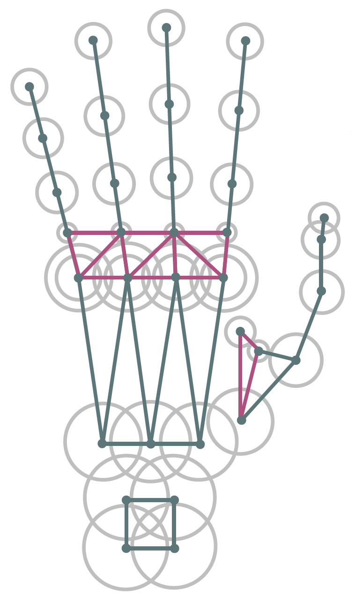
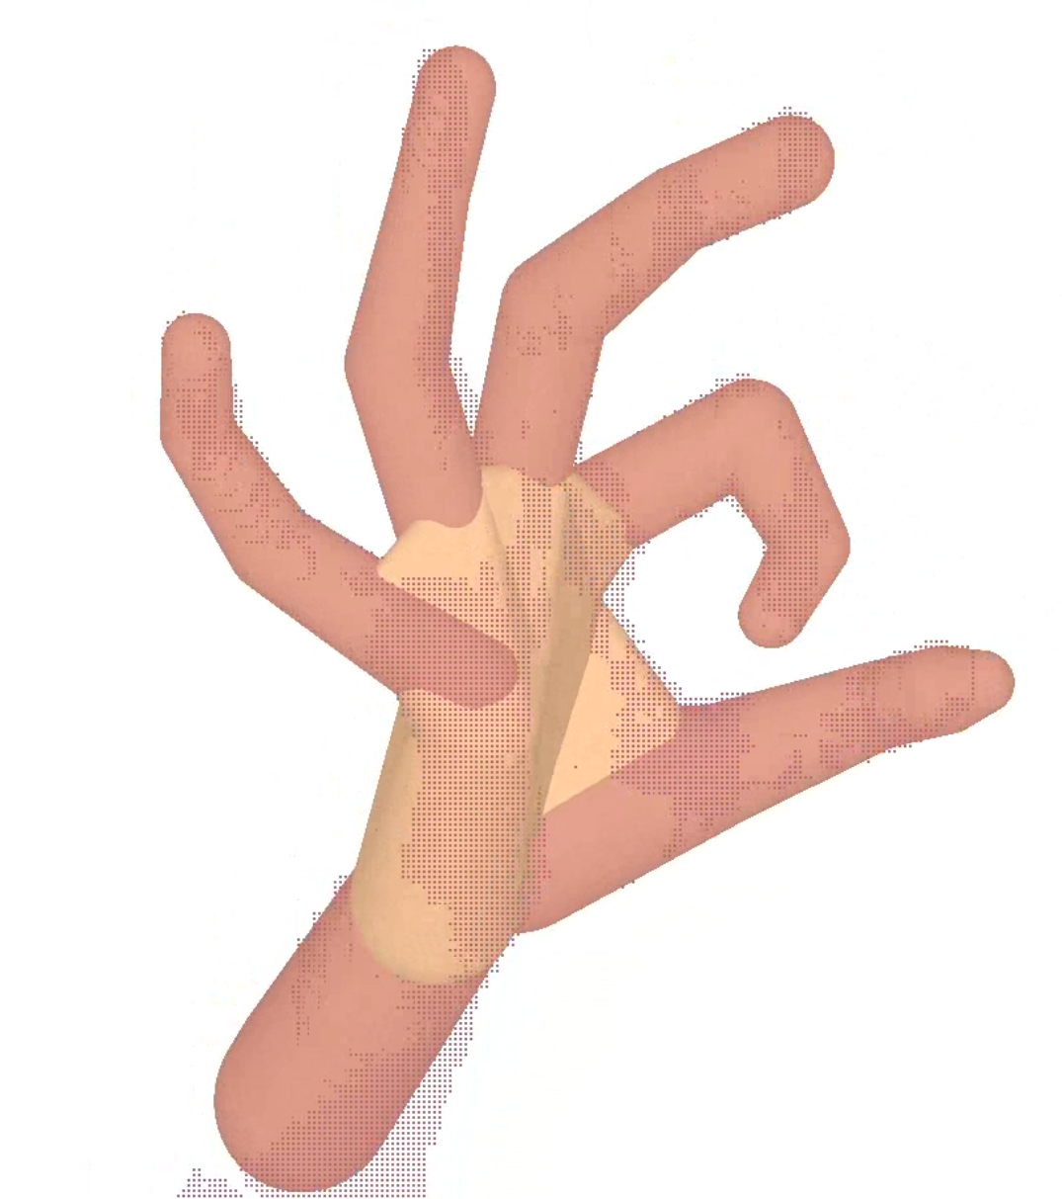
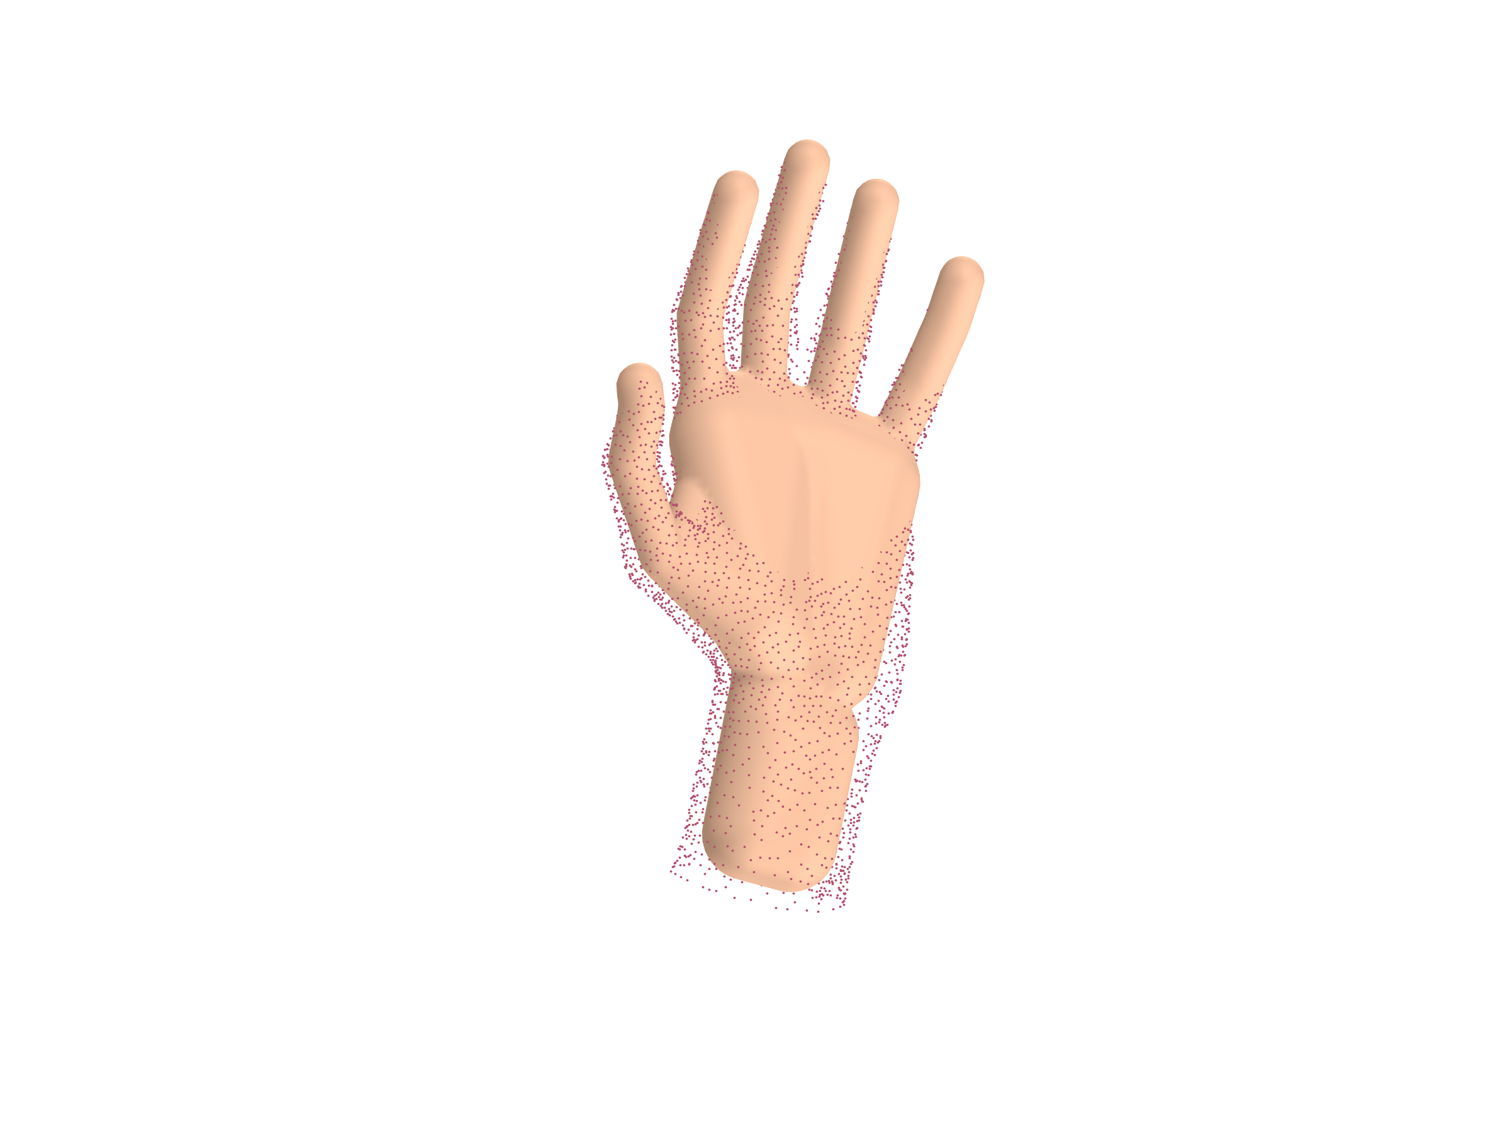
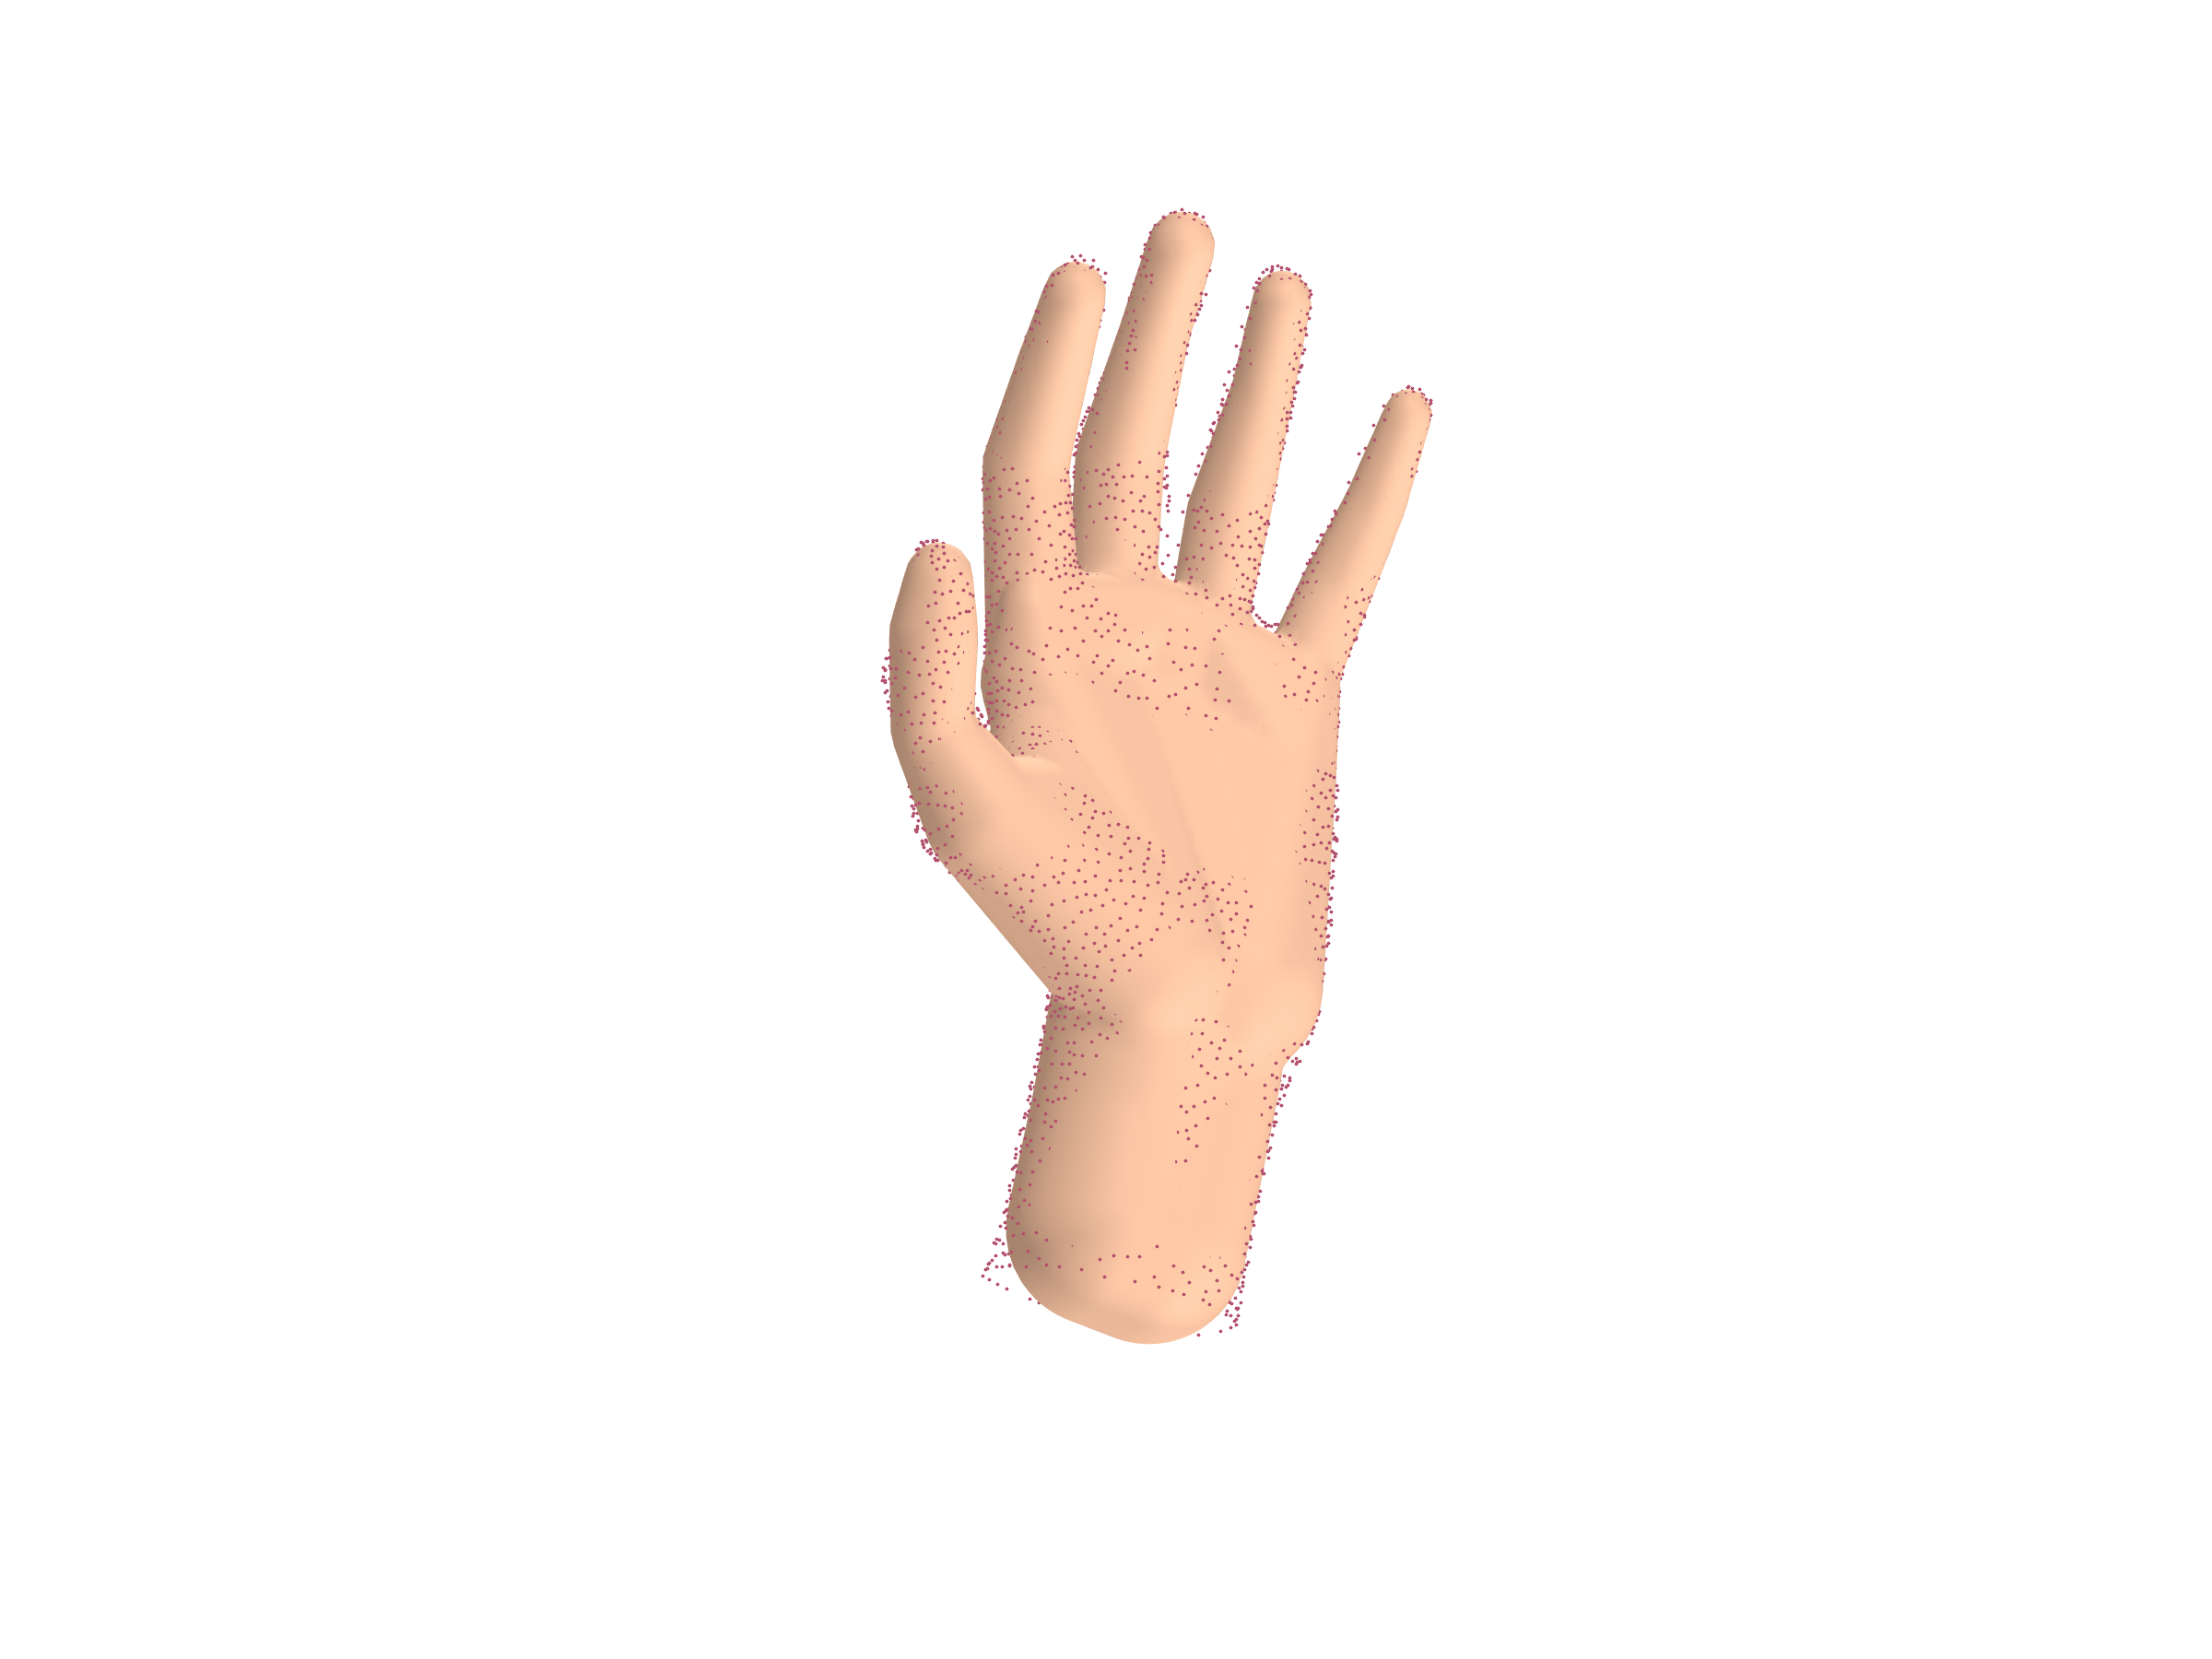
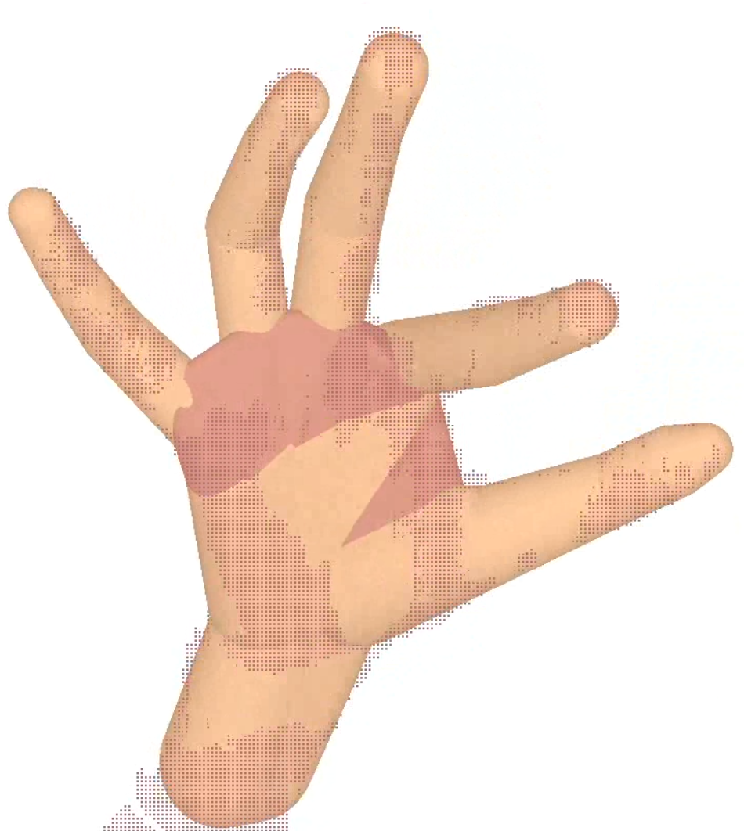
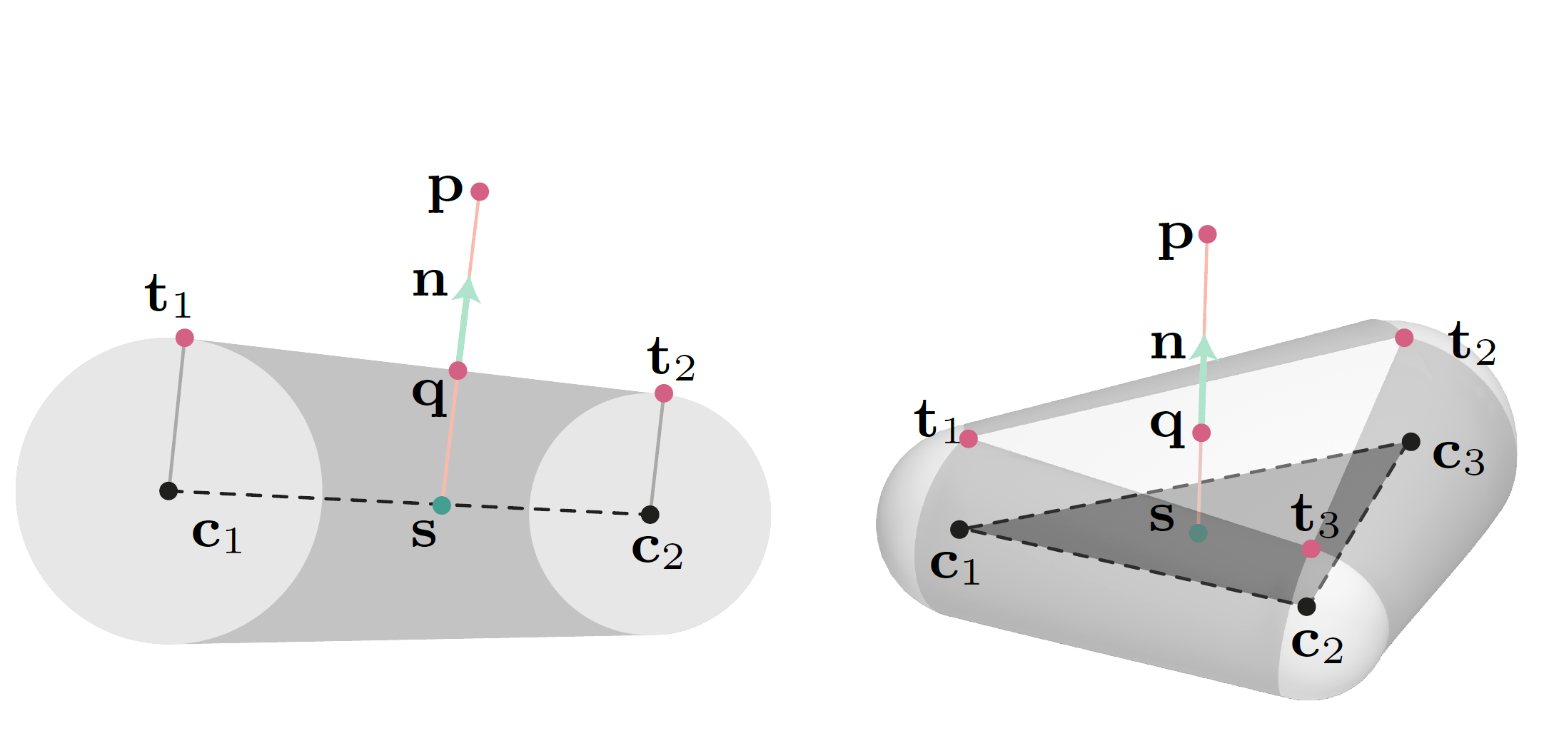
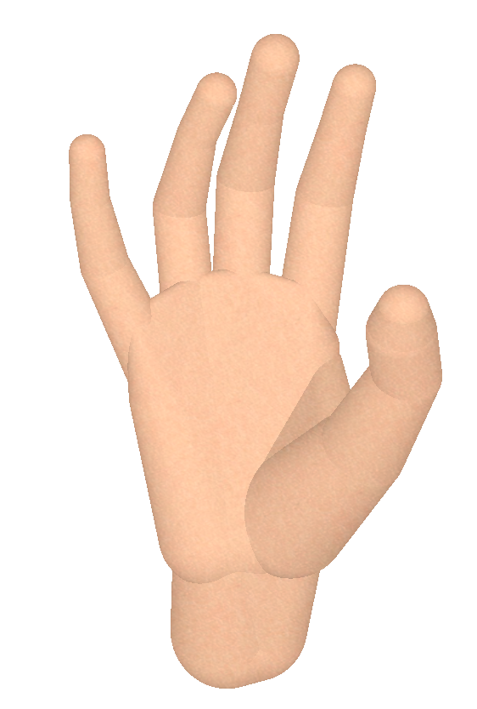
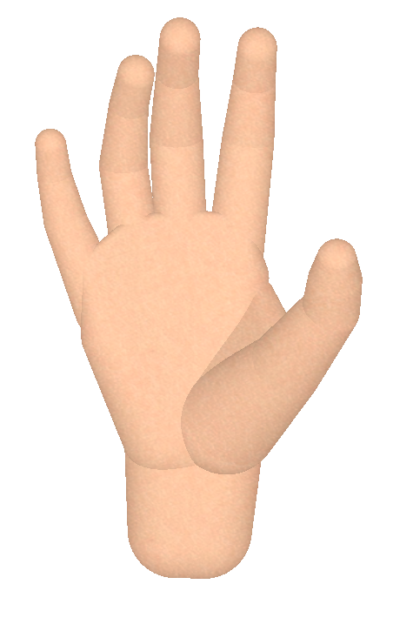
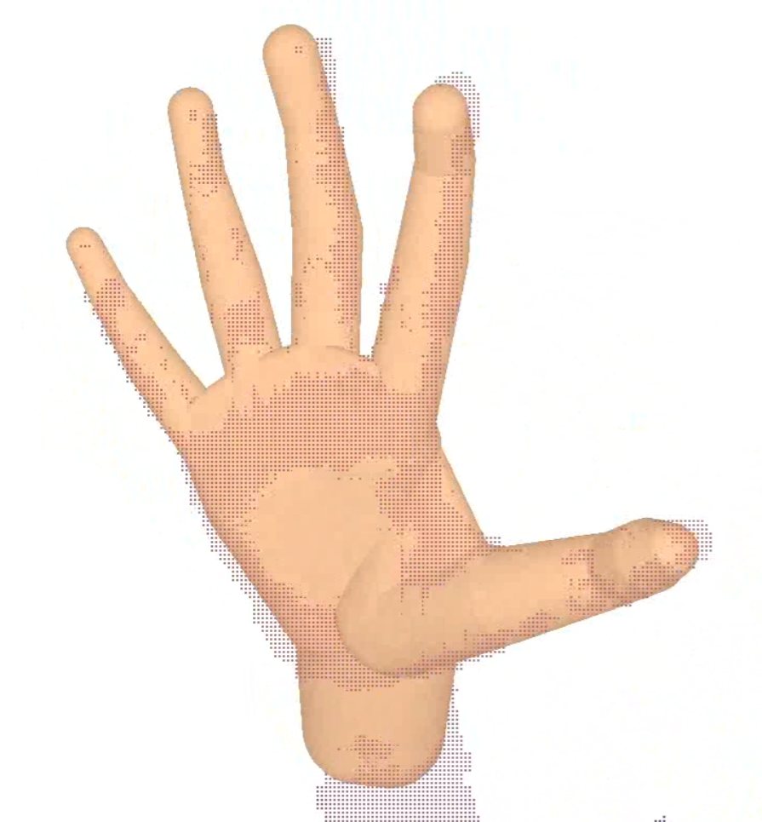
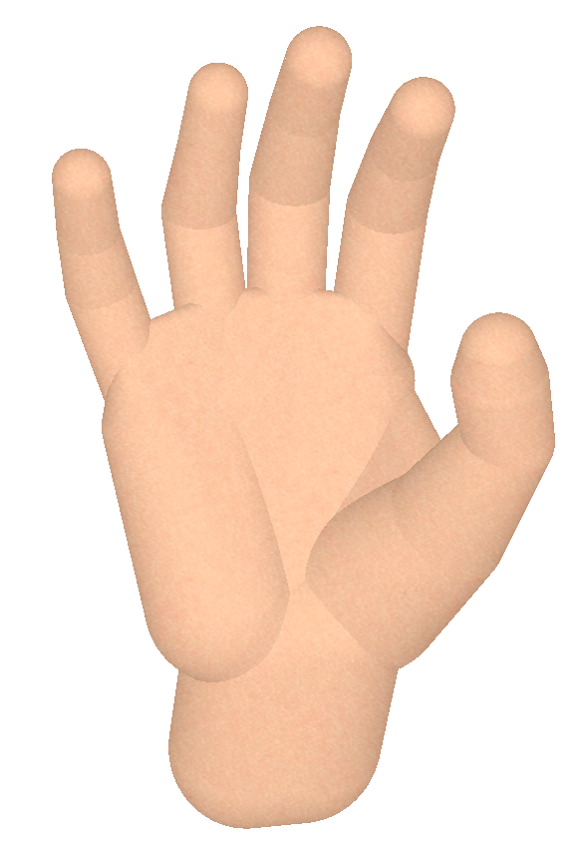
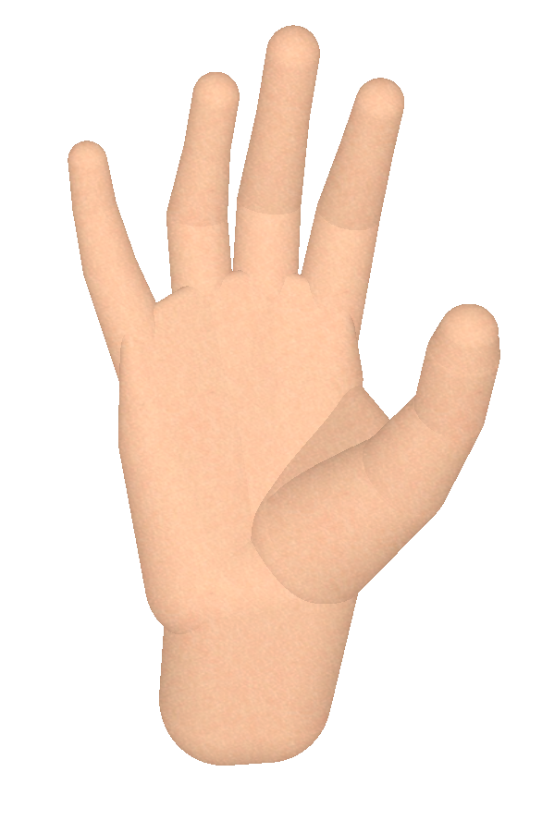
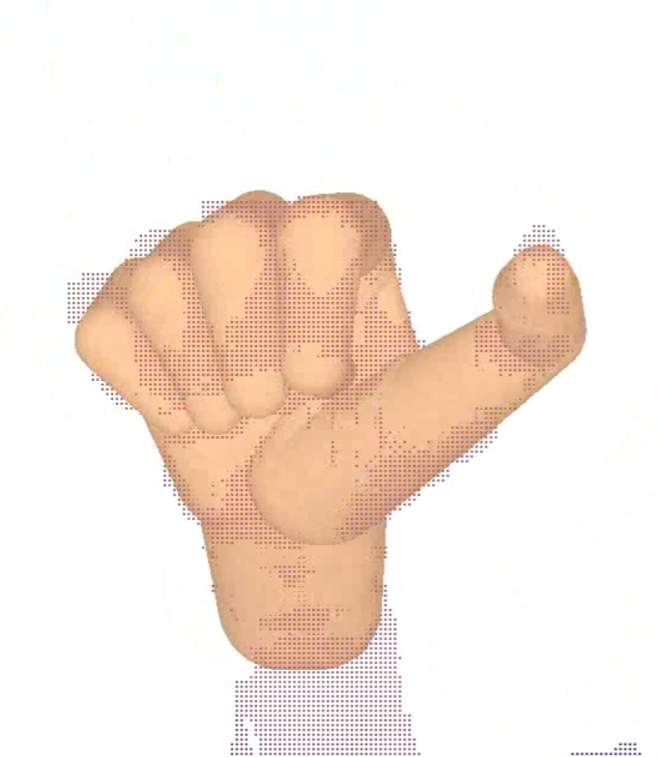
Convolution Models for Real-Time
Hand Modeling and Tracking

Slide 3
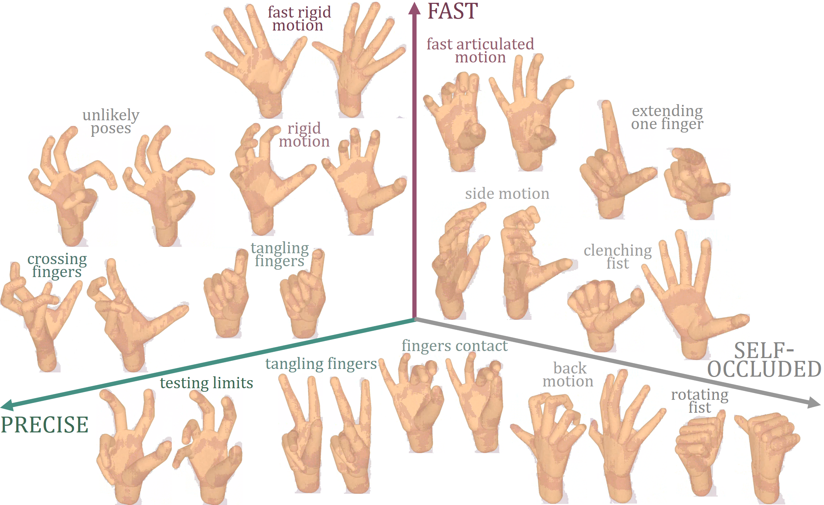
Convolution Models for Real-Time
Hand Modeling and Tracking

Slide 4
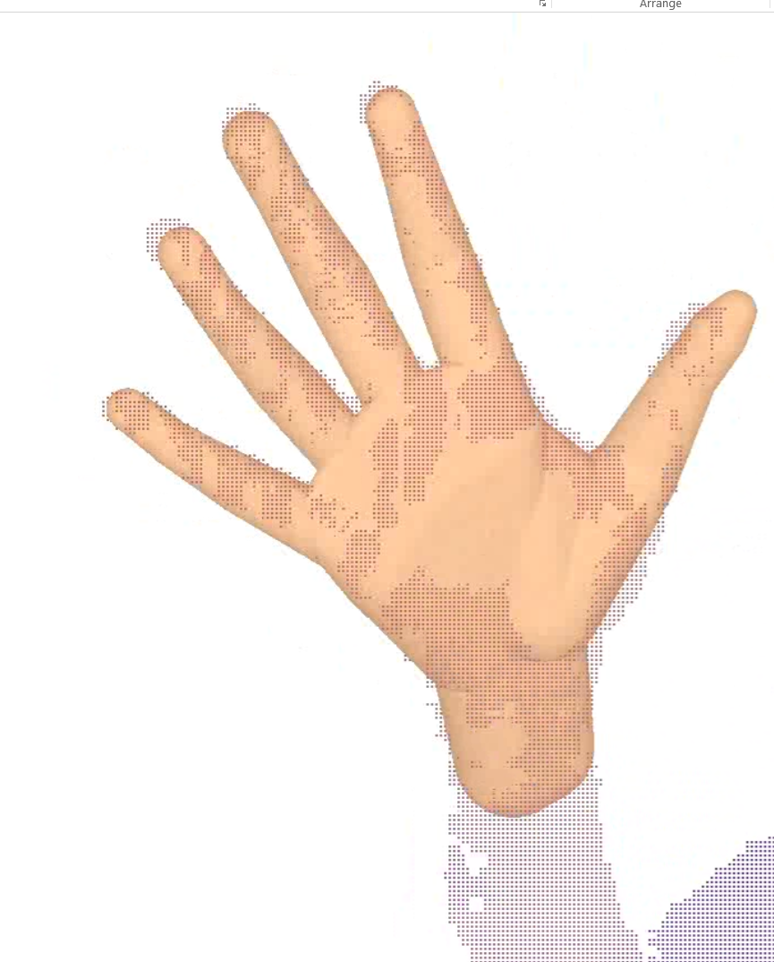
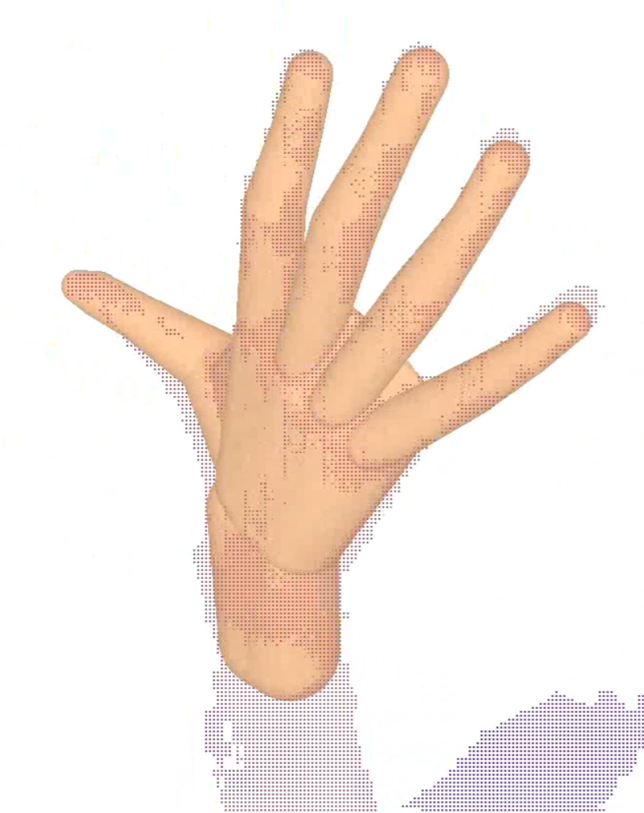
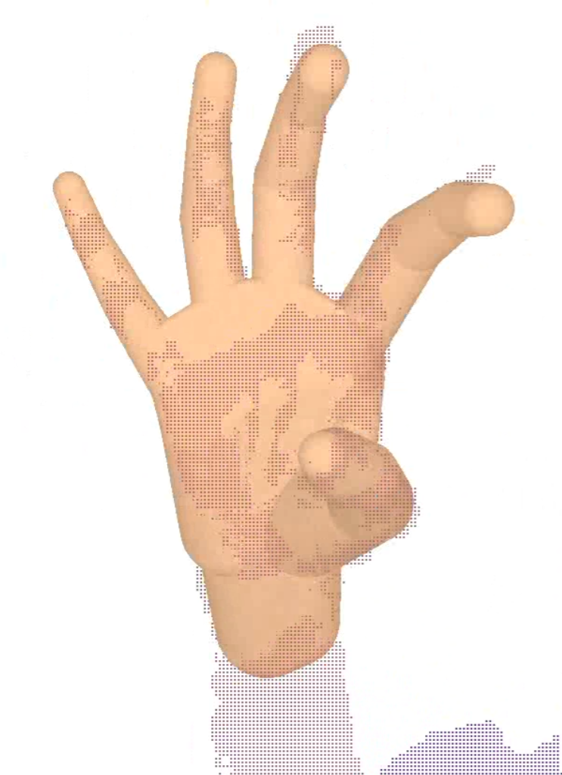
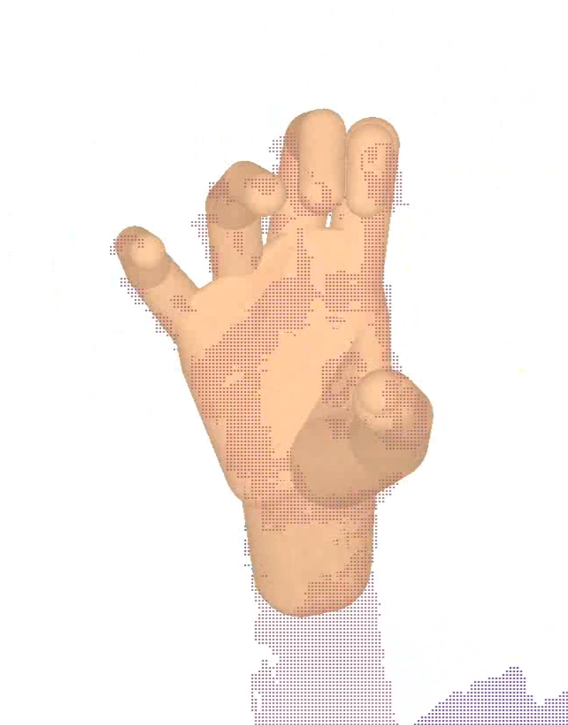
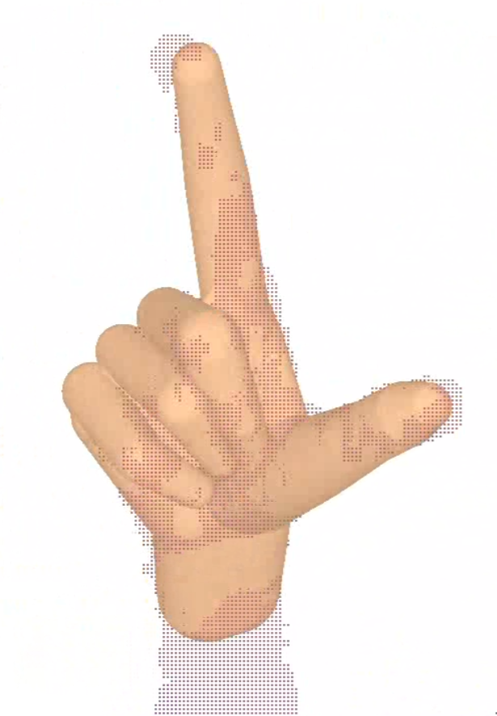
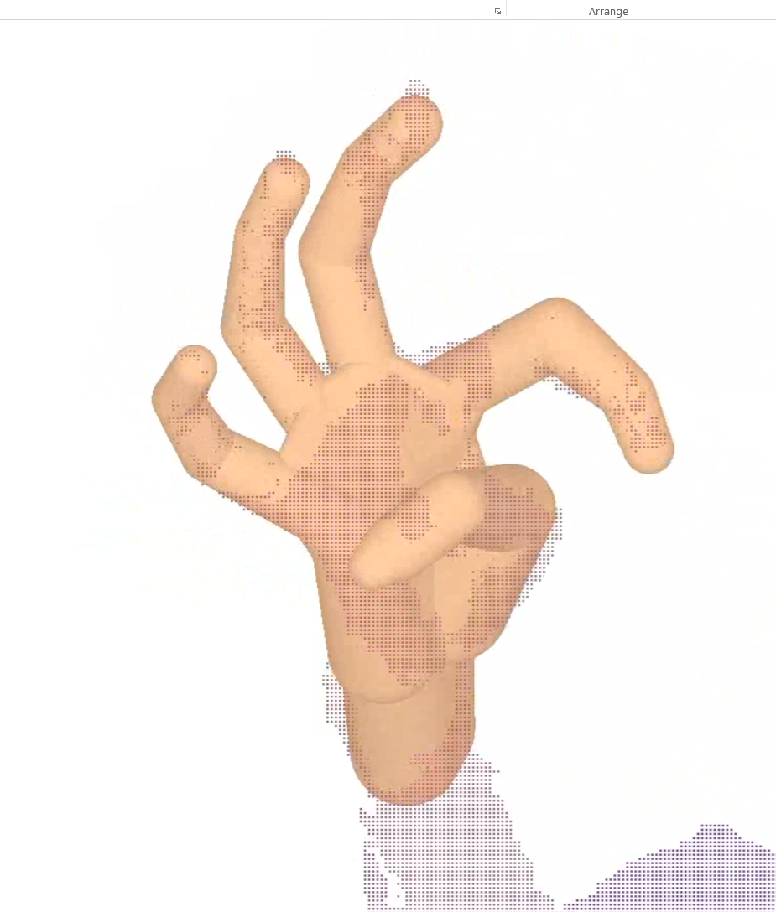
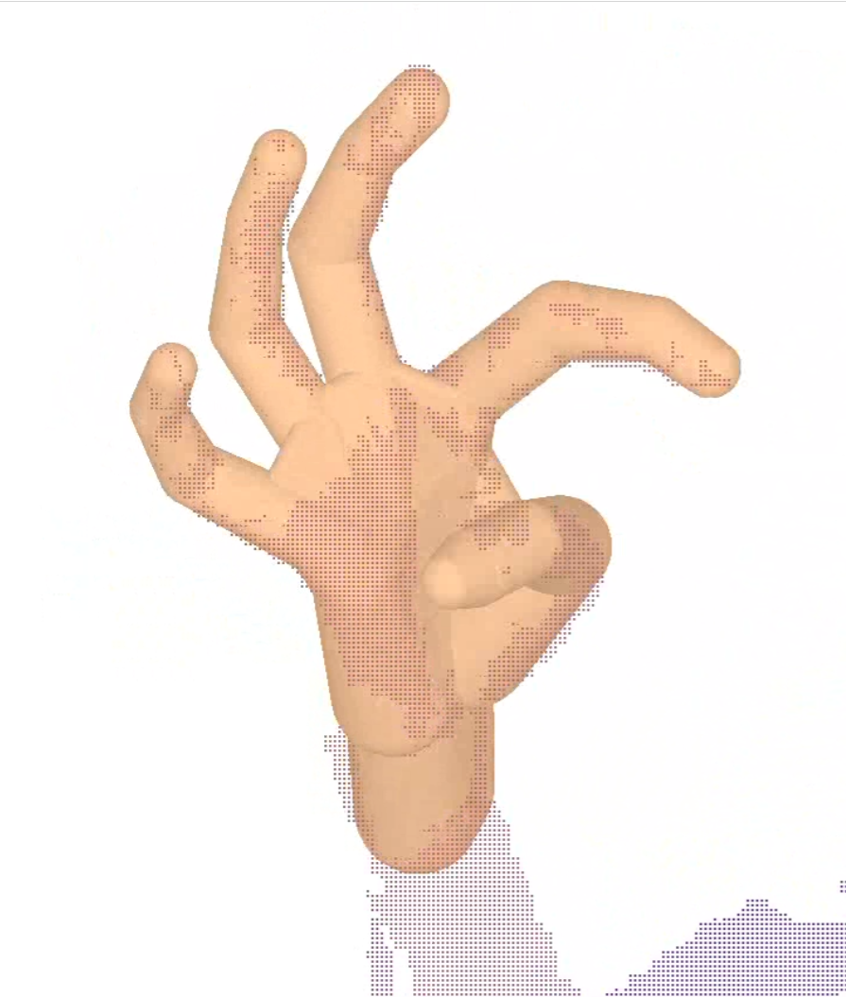
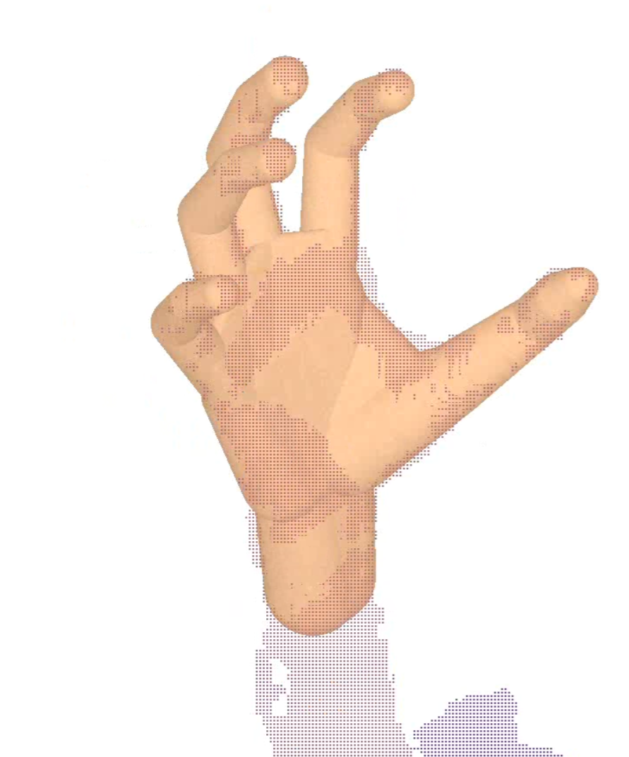
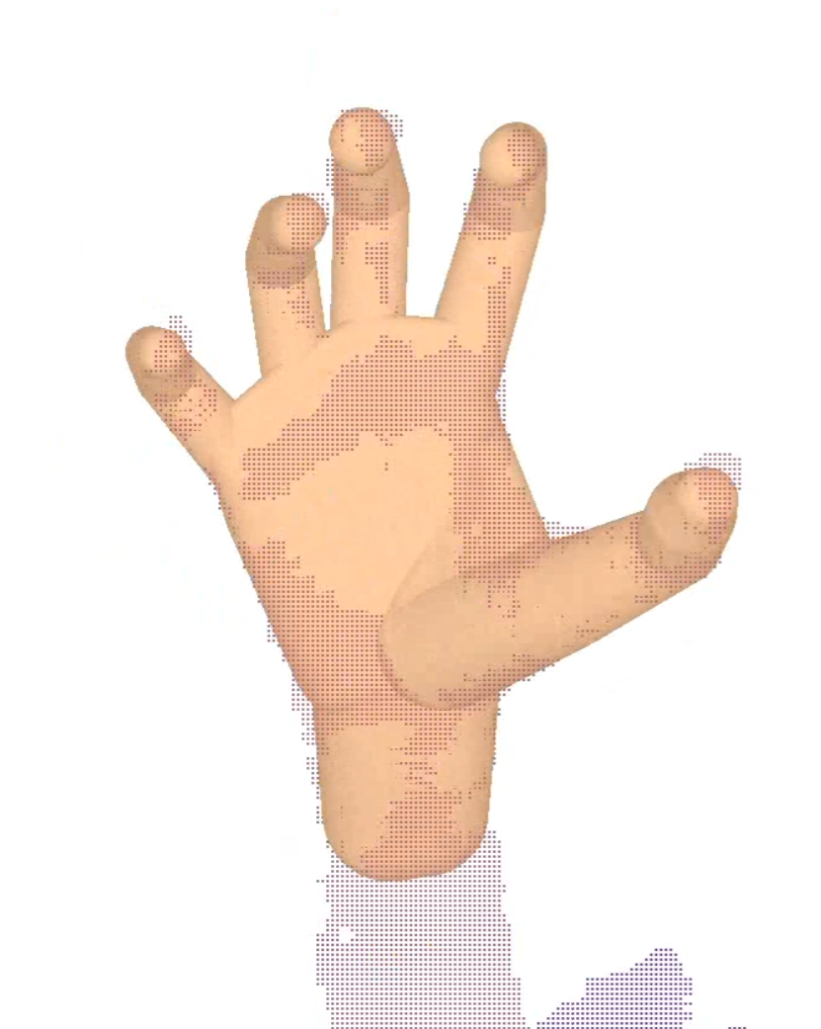
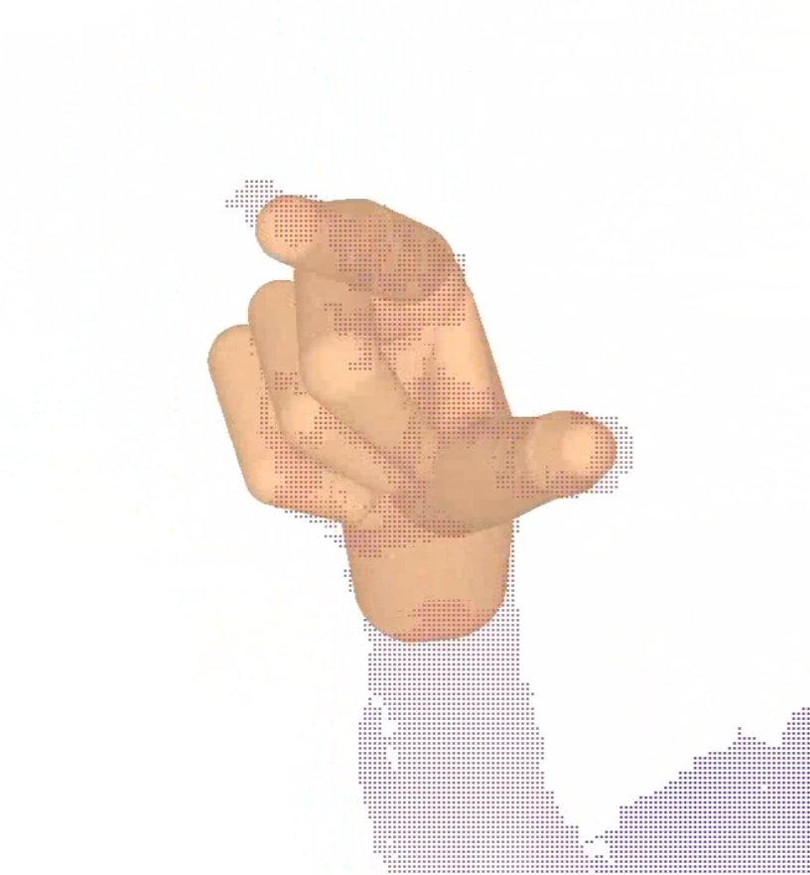
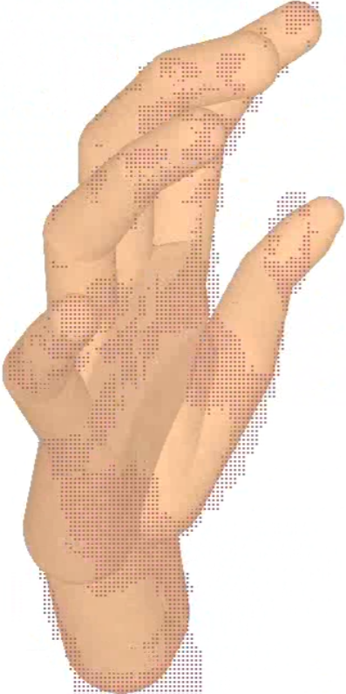
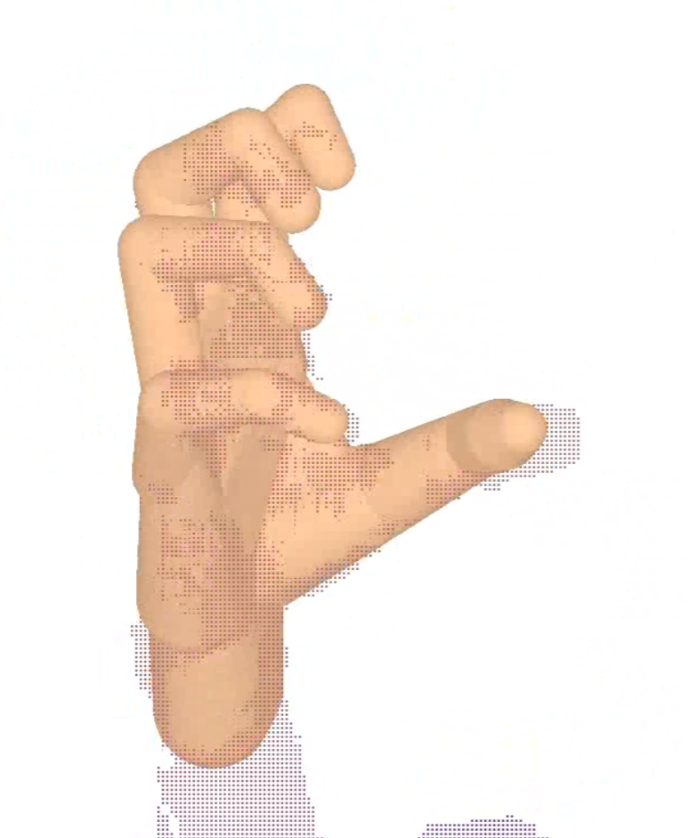
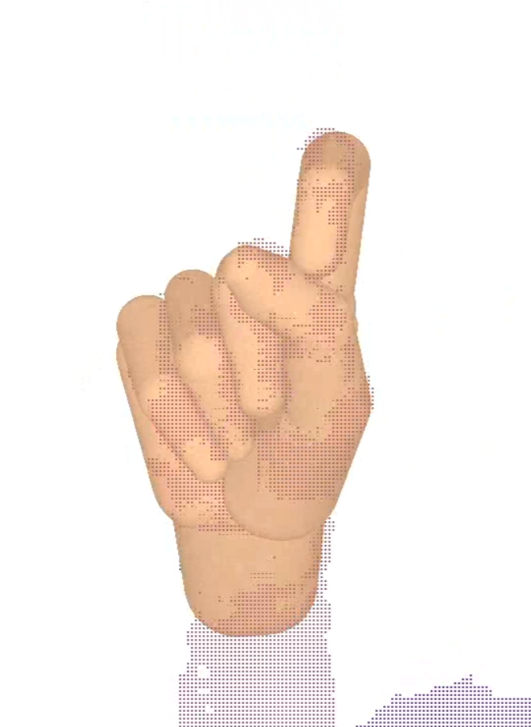
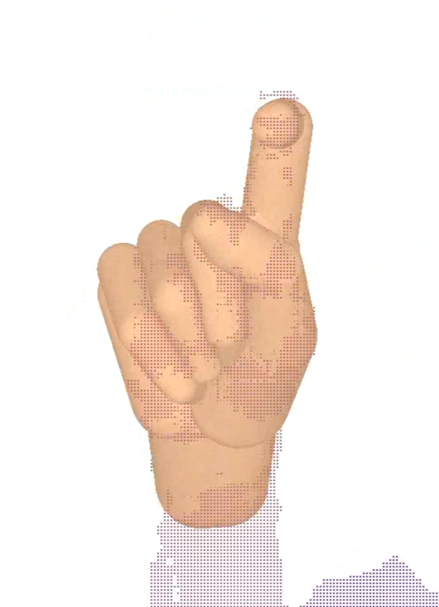
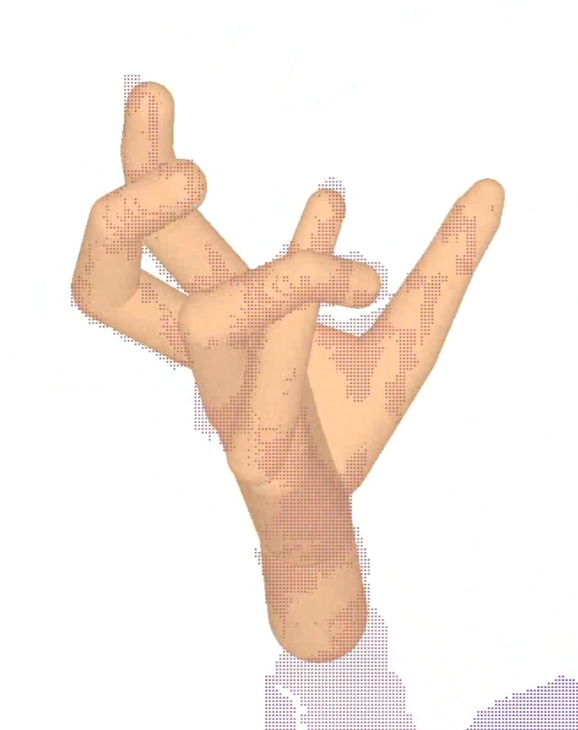
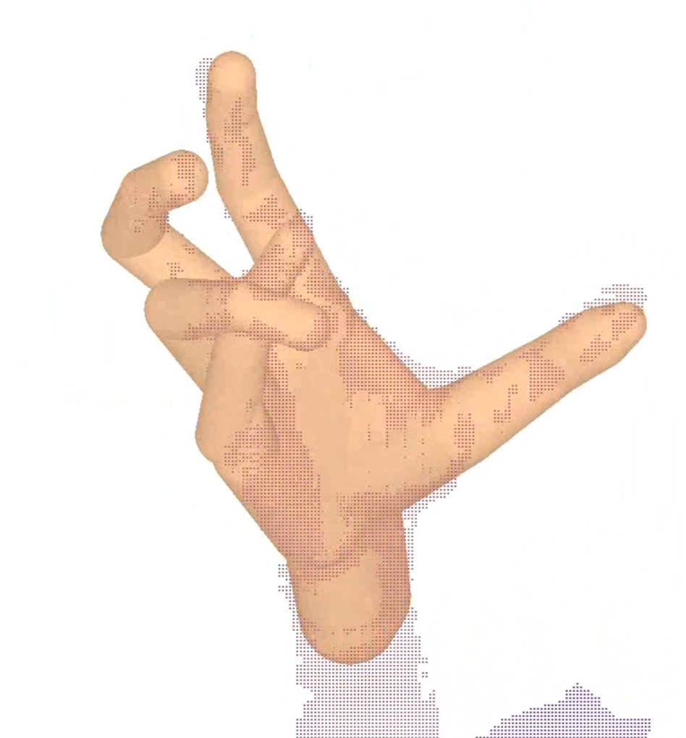
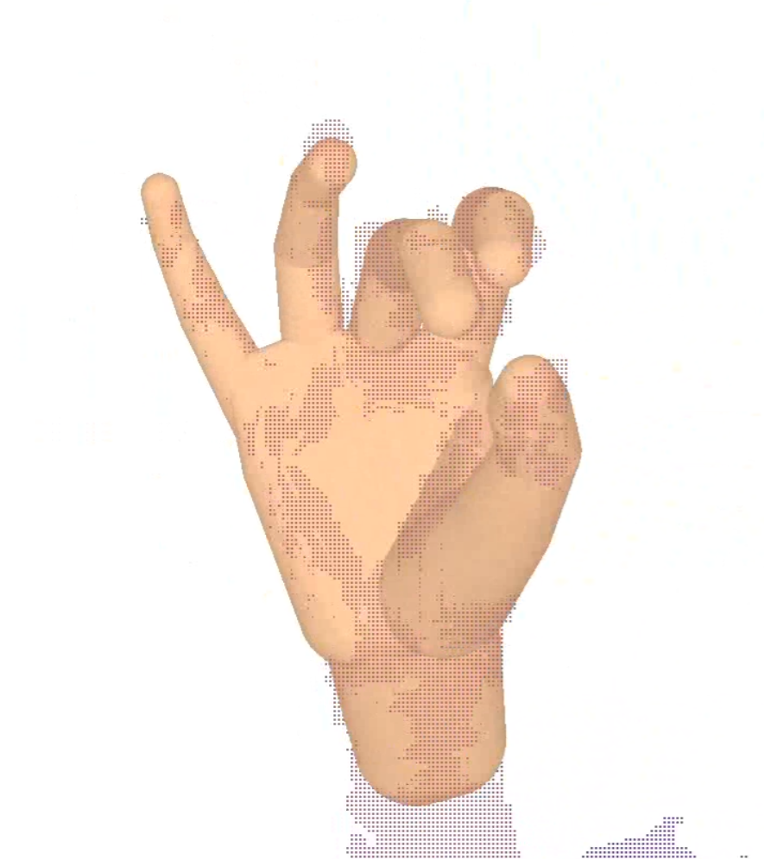
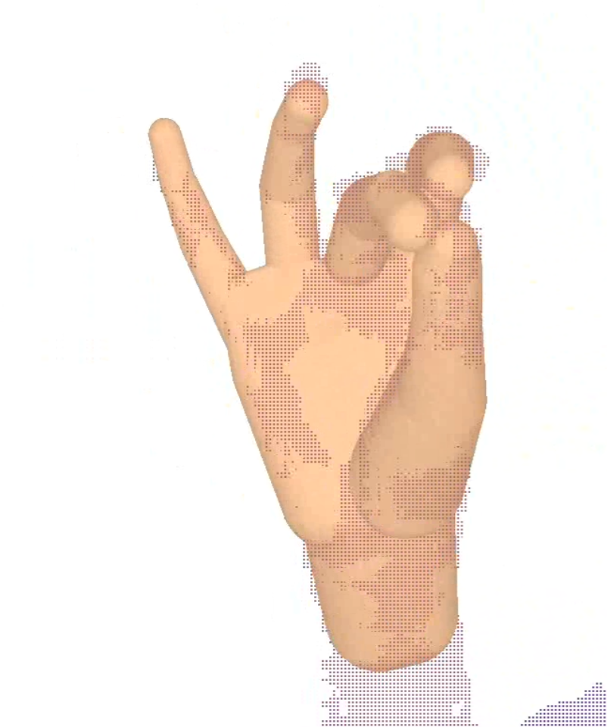
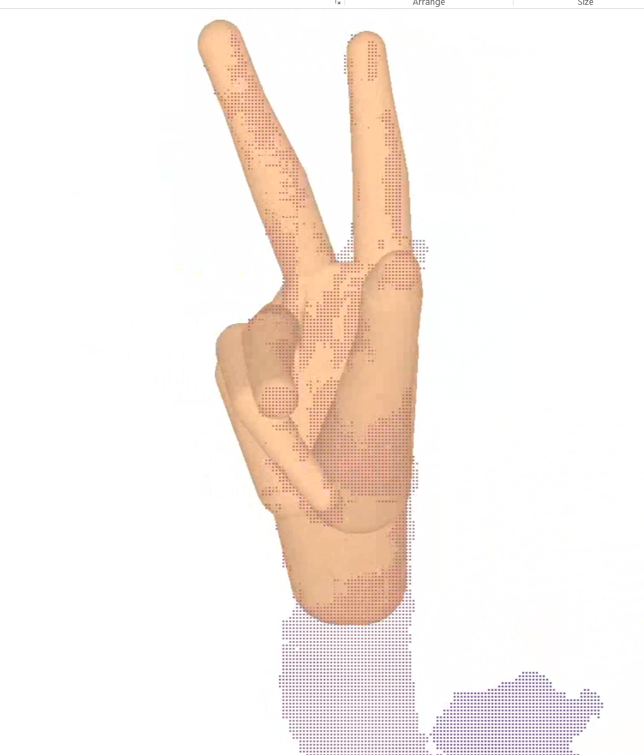
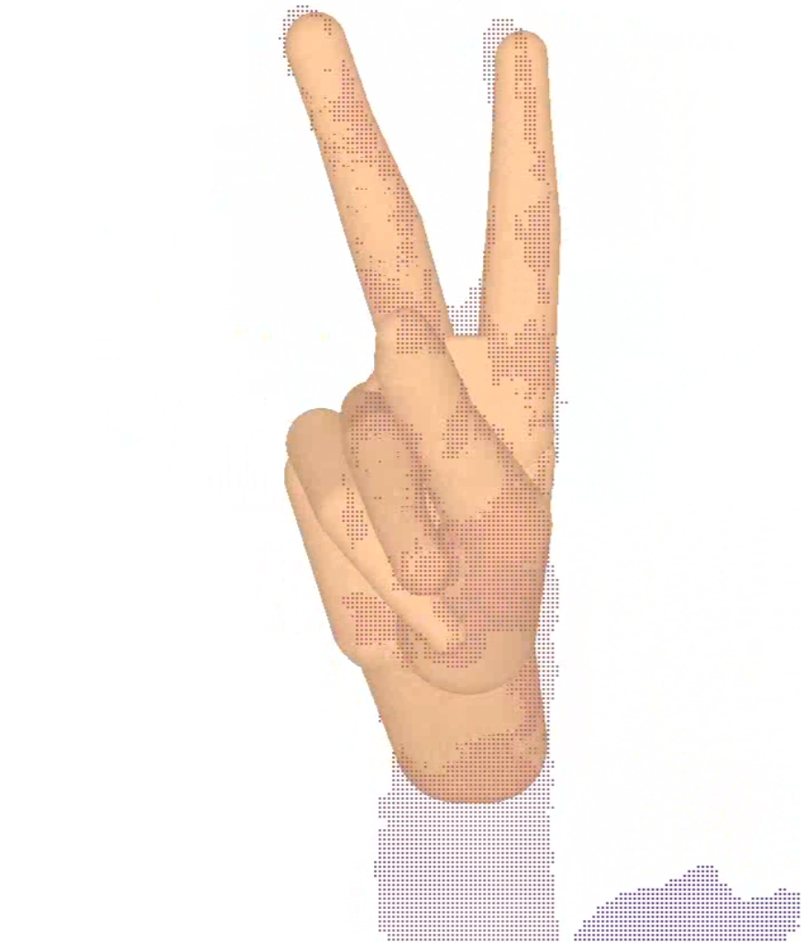
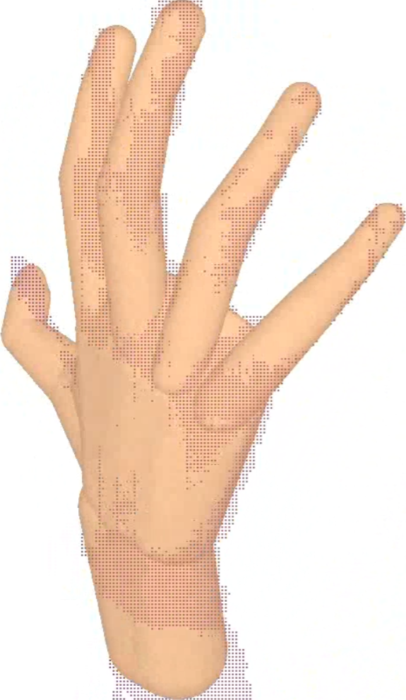
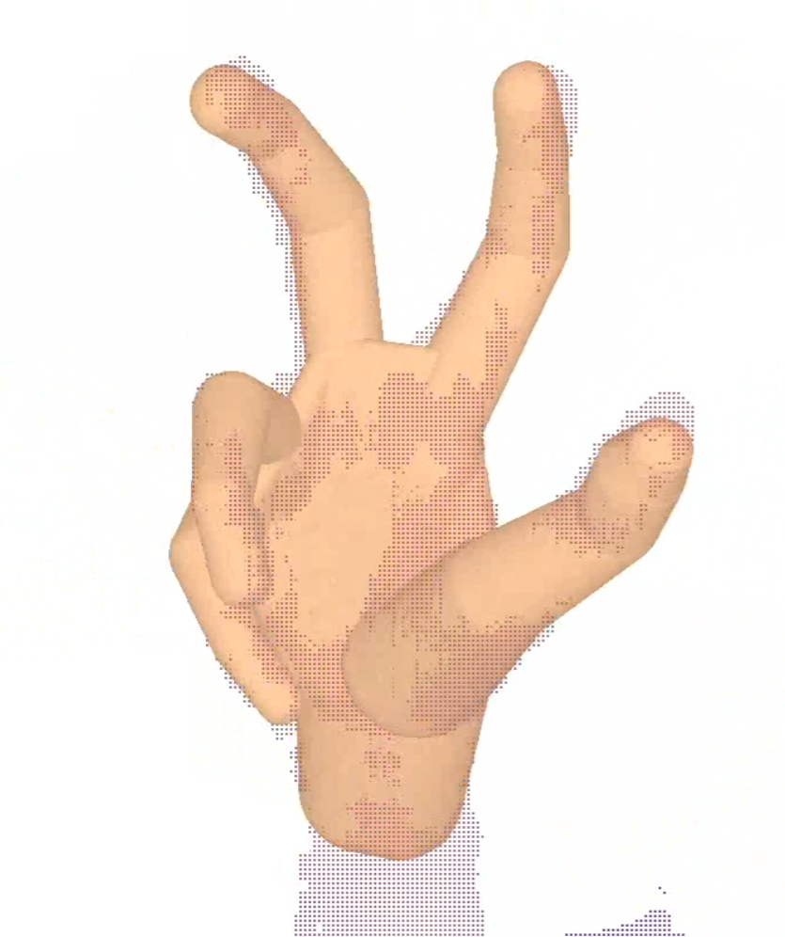
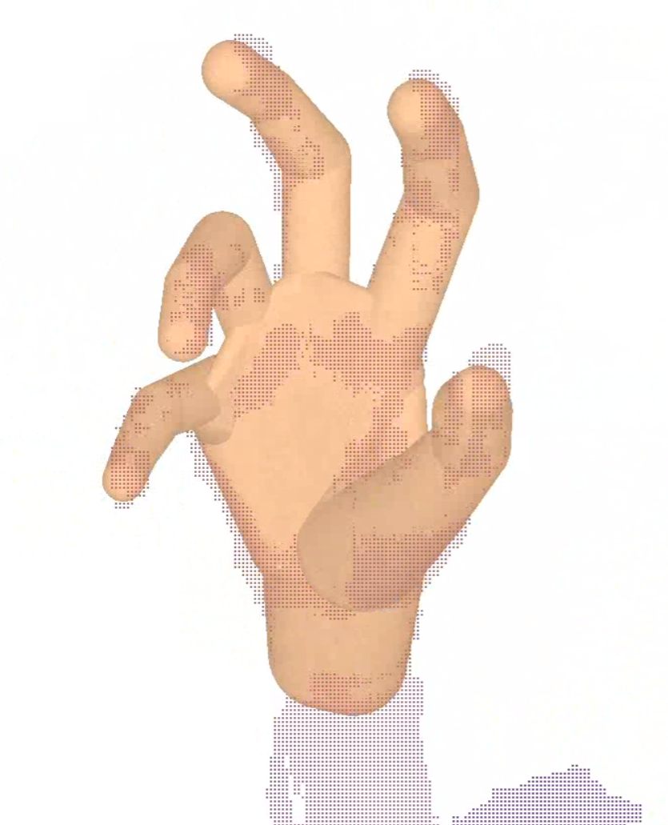
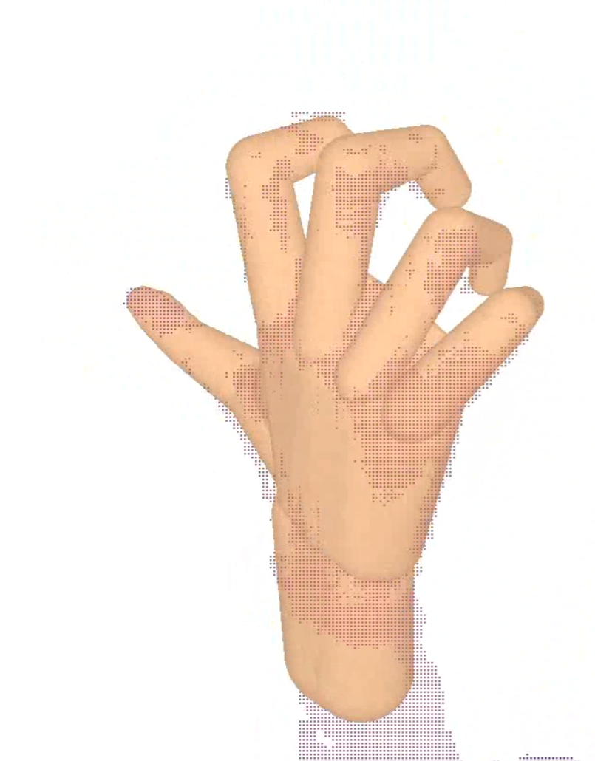
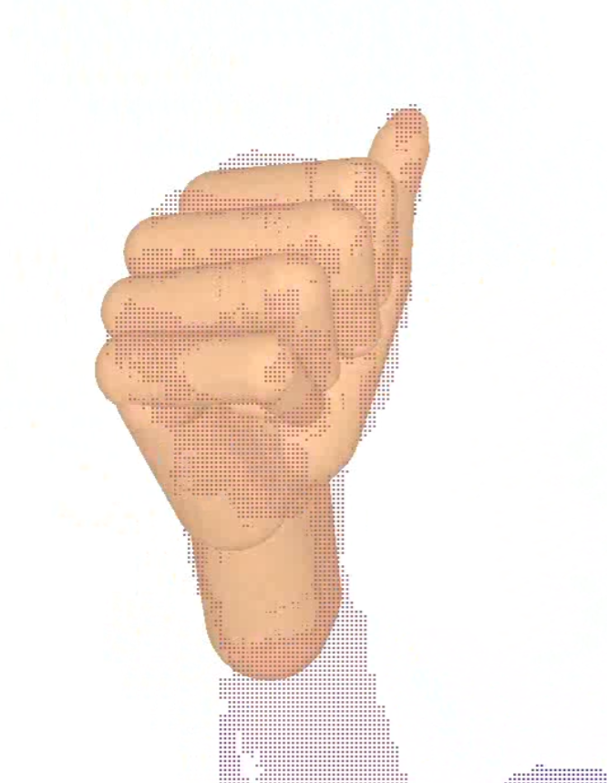
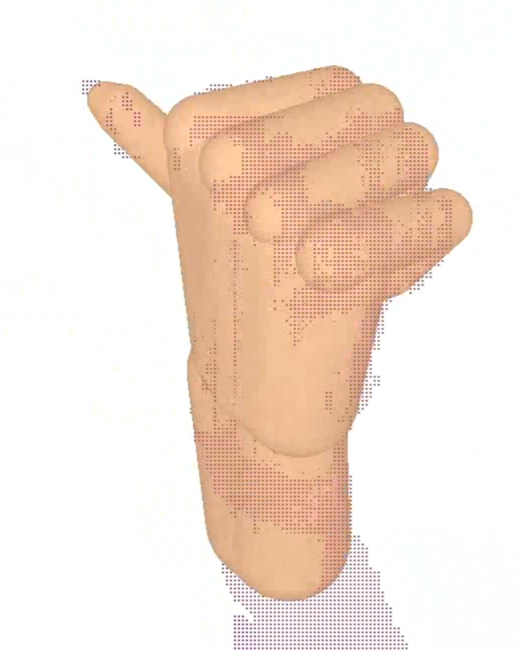
fast rigid motion
fast
fast articulated motion
unlikely poses
extending one finger
rigid motion
side motion
tangling fingers
clenching fist
crossing fingers
fingers contact
self-occluded
tangling fingers
back motion
testing limits
rotating fist
precise

Slide 8
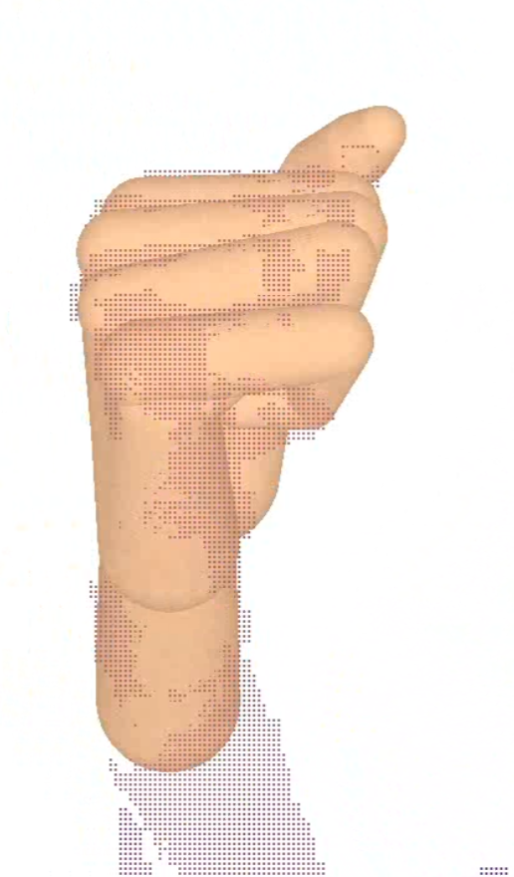
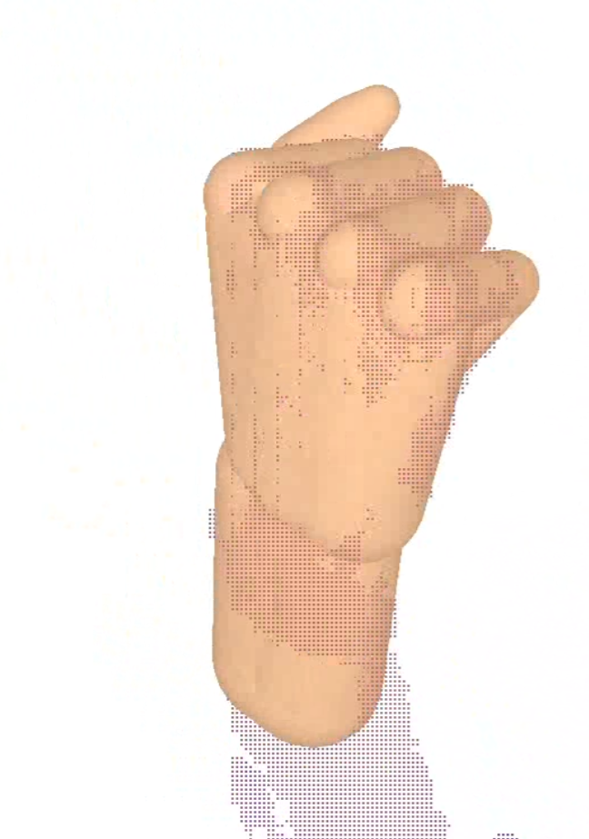
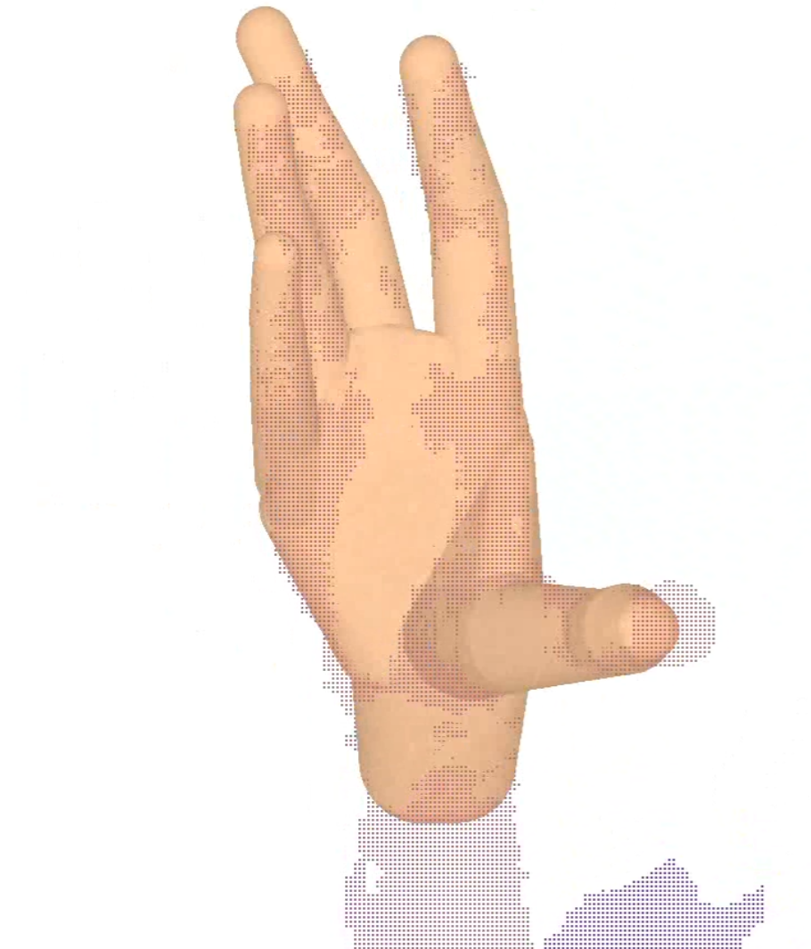
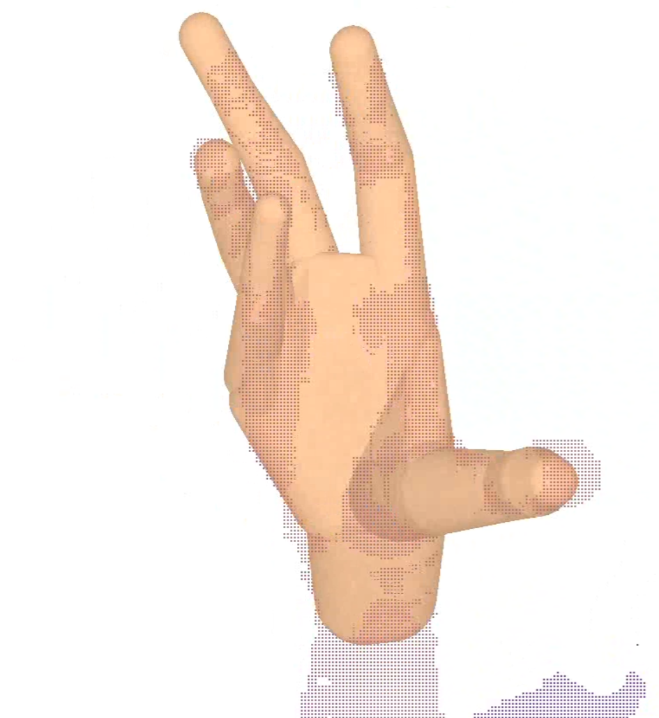
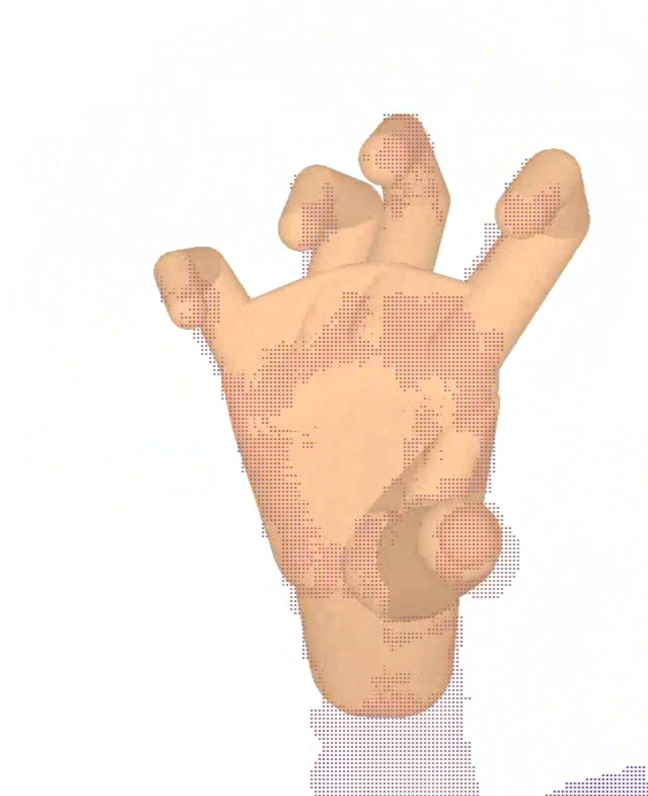
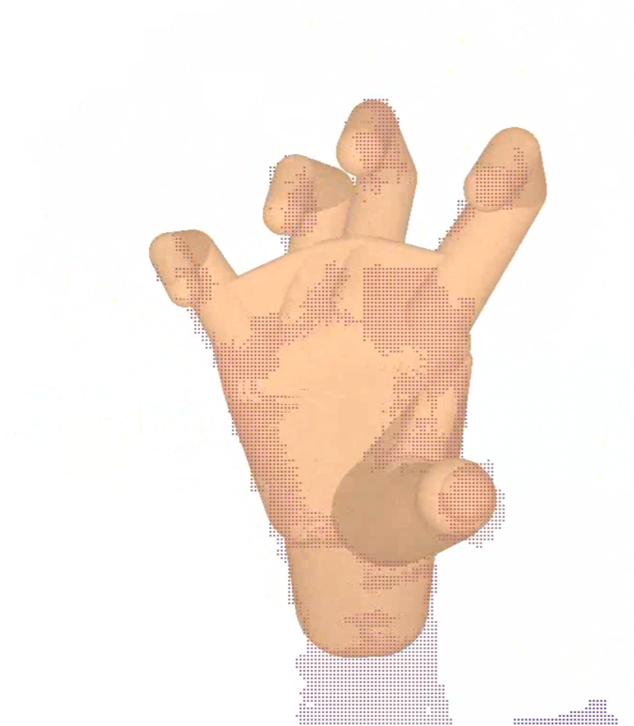

Slide 9
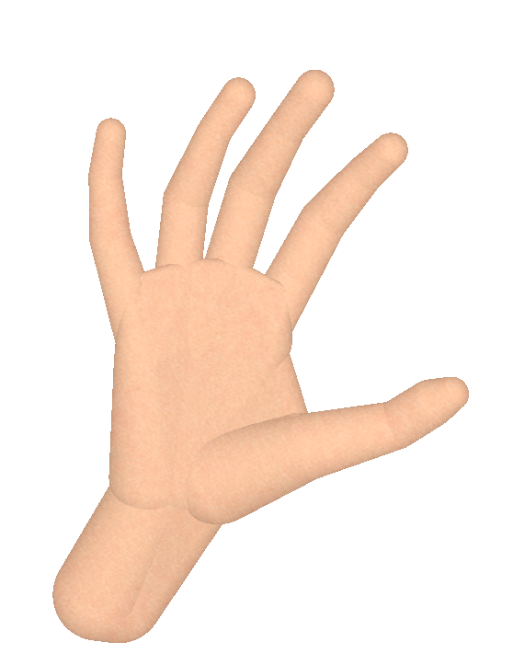
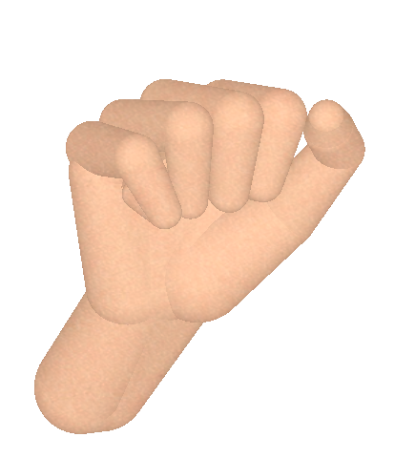

Slide 10
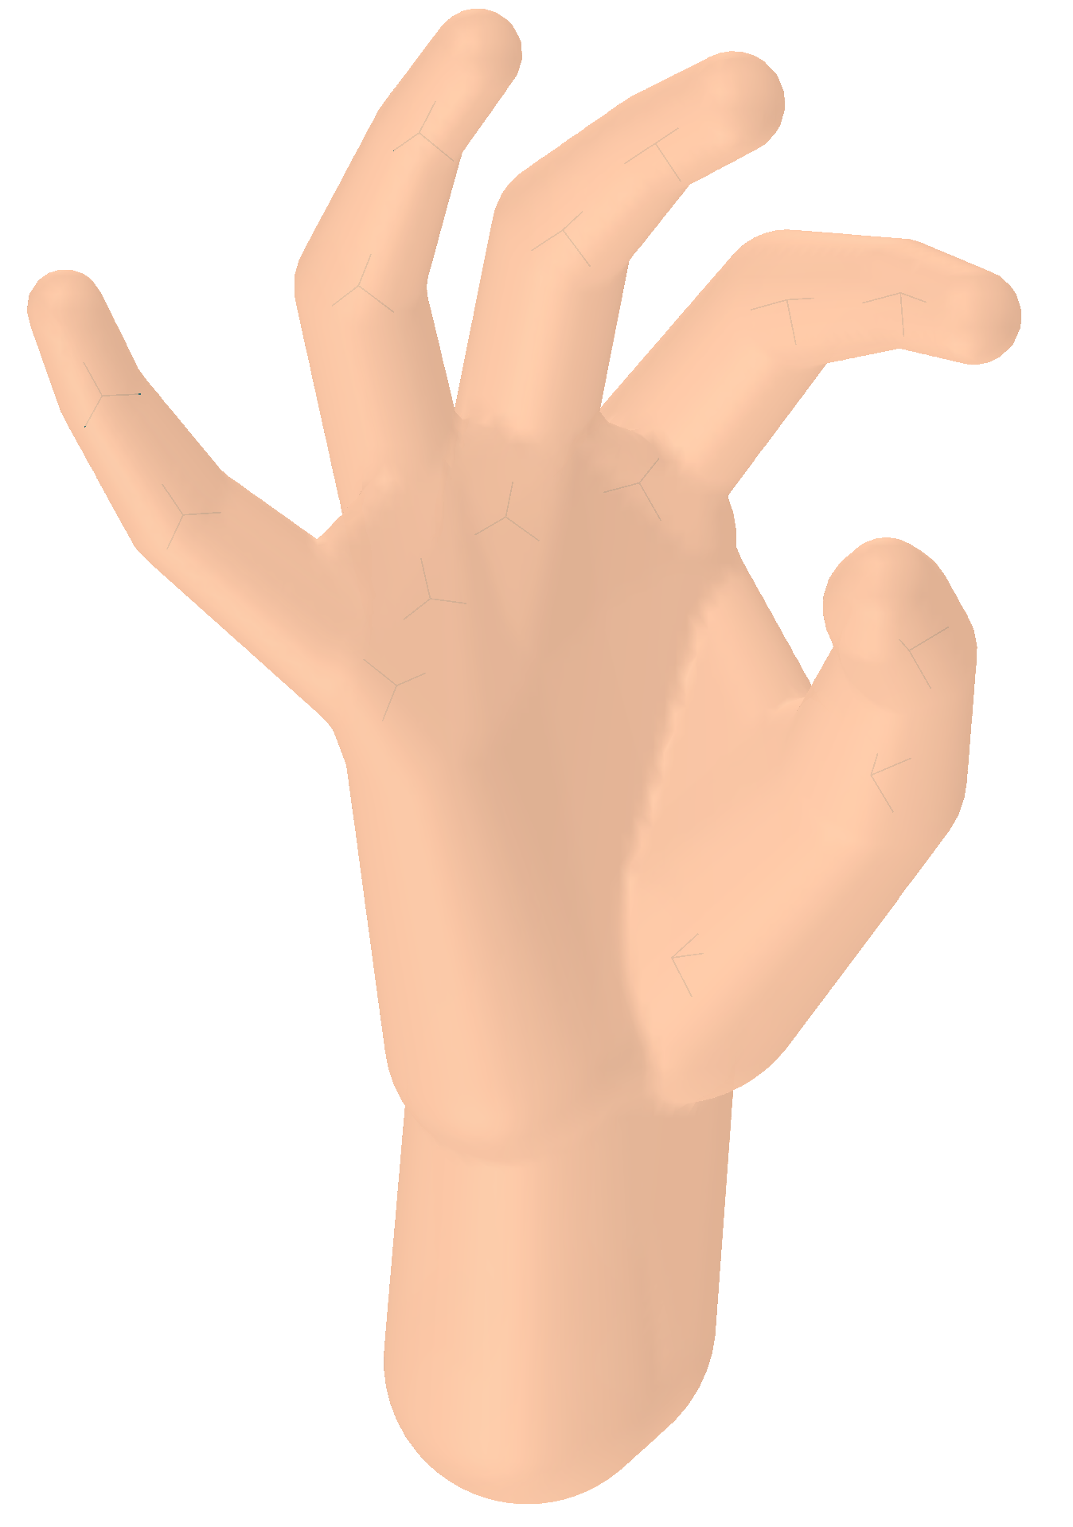
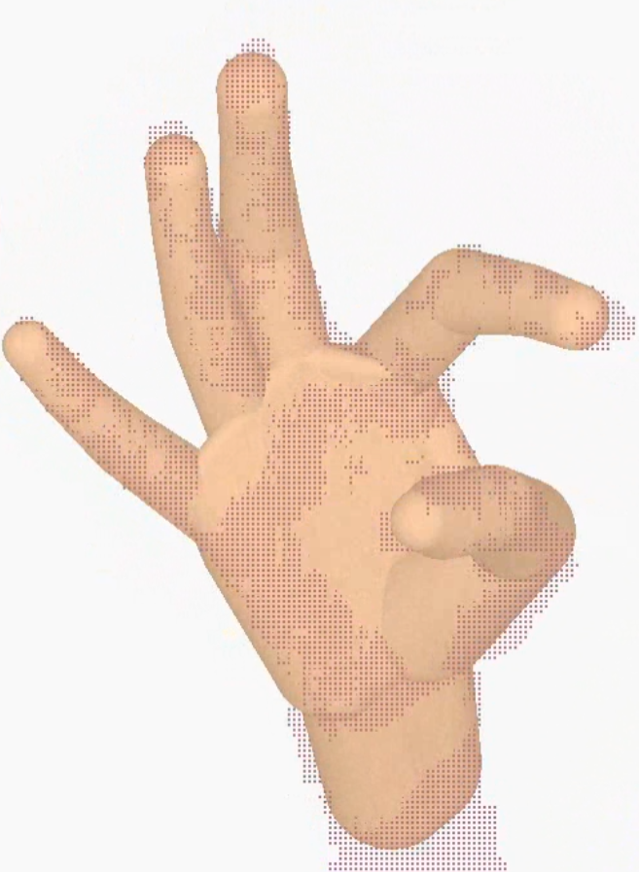
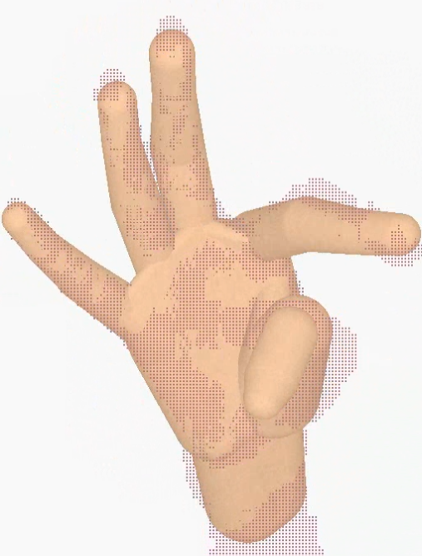


Slide 11





1 DOF
2 DOF
6 DOF

Slide 13


Slide 14


Slide 15









Slide 16




Slide 17




$$p$$
$$v$$
$$n$$
$$m$$

Slide 18



















$$c_{1}$$
$$c_{2}$$
$$p$$
$$q$$
$$ω$$
$$y$$
$$t$$
$$γ$$
$$δ$$
$$z_{13}$$
$$s$$
$$f$$
$$h$$
$$v_{1}$$
$$β$$
$$c_{1}$$
$$g$$
$$z$$
$$l$$
$$z_{12}$$

Slide 19






$$c_{1}$$
$$c_{2}≡s_{12}$$
$$s_{23}$$
$$p$$
$$c_{3}$$

Slide 20
















$$q_{2}$$
$$p_{2}$$
$$p_{6}$$
$$p_{1}$$
$$q_{6}$$
$$q_{1}$$
$$p_{3}$$
$$q_{5}$$
$$p_{5}$$
$$p_{4}$$
$$q_{4}$$
$$q_{3}$$
query point
front-facing correspondence
back-facing correspondence
$$p_{8}$$
$$q_{9}$$
$$p_{9}$$
camera view direction
$$q_{8}$$

Slide 21



$$q_{1}$$
$$p$$
$$q_{2}$$

Slide 22


















$$v_{3}$$
$$v_{1}$$
$$r_{3}$$
$$c_{3}$$
$$u_{3}$$
$$r_{1}$$
$$c_{1}$$
$$r_{1}$$
$$c_{1}$$
$$u_{1}$$
$$v_{2}$$
$$r_{2}$$
$$r_{2}$$
$$c_{2}$$
$$u_{2}$$
$$c_{2}$$

Slide 23



Slide 24



Slide 25




Slide 26
1
2
3
5
4
6
7
8
9
21
11
10
23
12
25
22
16
15
14
13
26
24
20
19
18
17

Slide 27
15
16
9
22
23
8
17
18
1
2
10
11
24
25
3
4
12
13
19
20
29
30
26
27
5
6
37
38
36
31
32
40
21
41
28
14
39
7
33
34
49
43
44
35
42
45
46
47
48

Slide 28
9
5
13
1
10
6
14
2
7
17
11
15
3
29
30
18
28
8
12
16
4
19
23
22
20
24
25
26
27

Slide 29
15
8
22
17
18
1
10
11
24
25
3
4
12
13
19
20
29
26
27
5
6
37
38
36
31
32
40
21
41
28
14
39
7
33
34
49
43
44
35
42
45
46
47
48

Slide 30
15
8
22
17
18
1
10
11
3
4
12
13
5
6
36
39
14
7

Slide 31
9
13
5
1
10
14
6
2
15
11
7
3
17
12
16
18
8
4
19
22
23
20
21
24
25
26
27

Slide 32
9
13
5
1
10
14
6
2
15
11
7
3
17
35
36
34
12
16
18
33
8
23
24
4
22
21
25
19
37
27
28
20
26
29
30
31
32

Slide 33
9
13
5
1
10
14
6
2
15
11
7
3
17
35
36
34
12
16
18
33
8
23
24
4
22
21
25
19
37
27
28
20
26
29
30
31
32

Slide 34
9
13
5
1
10
14
6
2
15
11
7
3
35
36
17
34
12
16
33
8
23
24
18
4
22
21
37
25
27
19
28
20
26
29
30
31
32

Slide 35










$$r_{3}$$
$$c_{3}$$
$$r_{1}$$
$$r_{1}$$
$$c_{1}$$
$$c_{1}$$
$$r_{2}$$
$$r_{2}$$
$$c_{2}$$
$$c_{2}$$

Slide 36












$$v_{3}$$
$$v_{1}$$
$$r_{3}$$
$$c_{3}$$
$$u_{3}$$
$$r_{1}$$
$$c_{1}$$
$$u_{1}$$
$$v_{2}$$
$$r_{2}$$
$$c_{2}$$
$$u_{2}$$

Slide 37













Slide 38


